Slide 1
using duolingo podcasts in the classroom
Duolingo for Schools
October 2022
Notes:
Introduce myself
“Icebreaker” for the audience - introduce yourself in the chat, tell me your favorite word in any language, what it means, and why it’s your favorite
Dépaysement
This word literally means “un-country-ness” and can describe anything from a change of scene to culture shock to disorientation.
Jaspiner
The French have quite a few words for the different kind of talk you can do, and jaspiner is one of them. It means to chatter, gab, or gossip. This is one of the most fun words to say on this list and the most fun to imagine. Jaspiner ignites an image of chattering with friends on the outdoor patio of a café in Paris in the 1950s, as the word is a little antiquated.
Housekeeping - it’s just me up here so I will be pausing to check the chat periodically, please feel free to ask questions or chat there! If you do have a question - use the + sign to turn it into a question, and others can upvote this question. Also this will make your questions stand out so I can see them!

Slide 2
what are duolingo podcasts?
Notes:
Spanish and French for English speakers
English for Spanish speakers and English for Portuguese speakers
You can listen on Apple or Google podcasts, or Spotify
The Duolingo Podcast delivers real-life stories in easy-to-understand French or Spanish with
English narration. There are three ways we make these stories easy for learners to follow:
● First, after we collect stories from our protagonists, language-learning experts simplify
the podcast script to a high A2 or low B1 language proficiency level on the CEFR scale.
This makes them accessible and interesting to students from advanced beginner
through advanced levels!
● Next, if we find that a particularly difficult word in the target language is necessary for
nuanced storytelling, we ask our English-speaking host to provide a quick explanation
or translation.
● Finally, the host also interjects intermittently to summarize and contextualize the target
language sections. These interjections serve as guideposts for learners who’ve gotten a
bit lost or simply need a brain break before we launch into more Spanish or French.
So, even though podcasts are not language lessons, they can be, with your help!

Slide 3
how can you use duolingo podcasts in the classroom?
Notes:
To help you incorporate this as a teaching tool, we’ve designed supplementary materials to
accompany the podcast episodes. You can just print and copy, or you can modify to suit the
unique needs of your students.
If you find something that works really well for you, please tell us! Your insights will allow us
to improve, to share your ideas with more teachers, and ultimately to support you even more.

Slide 4
duolingo resources

Slide 5
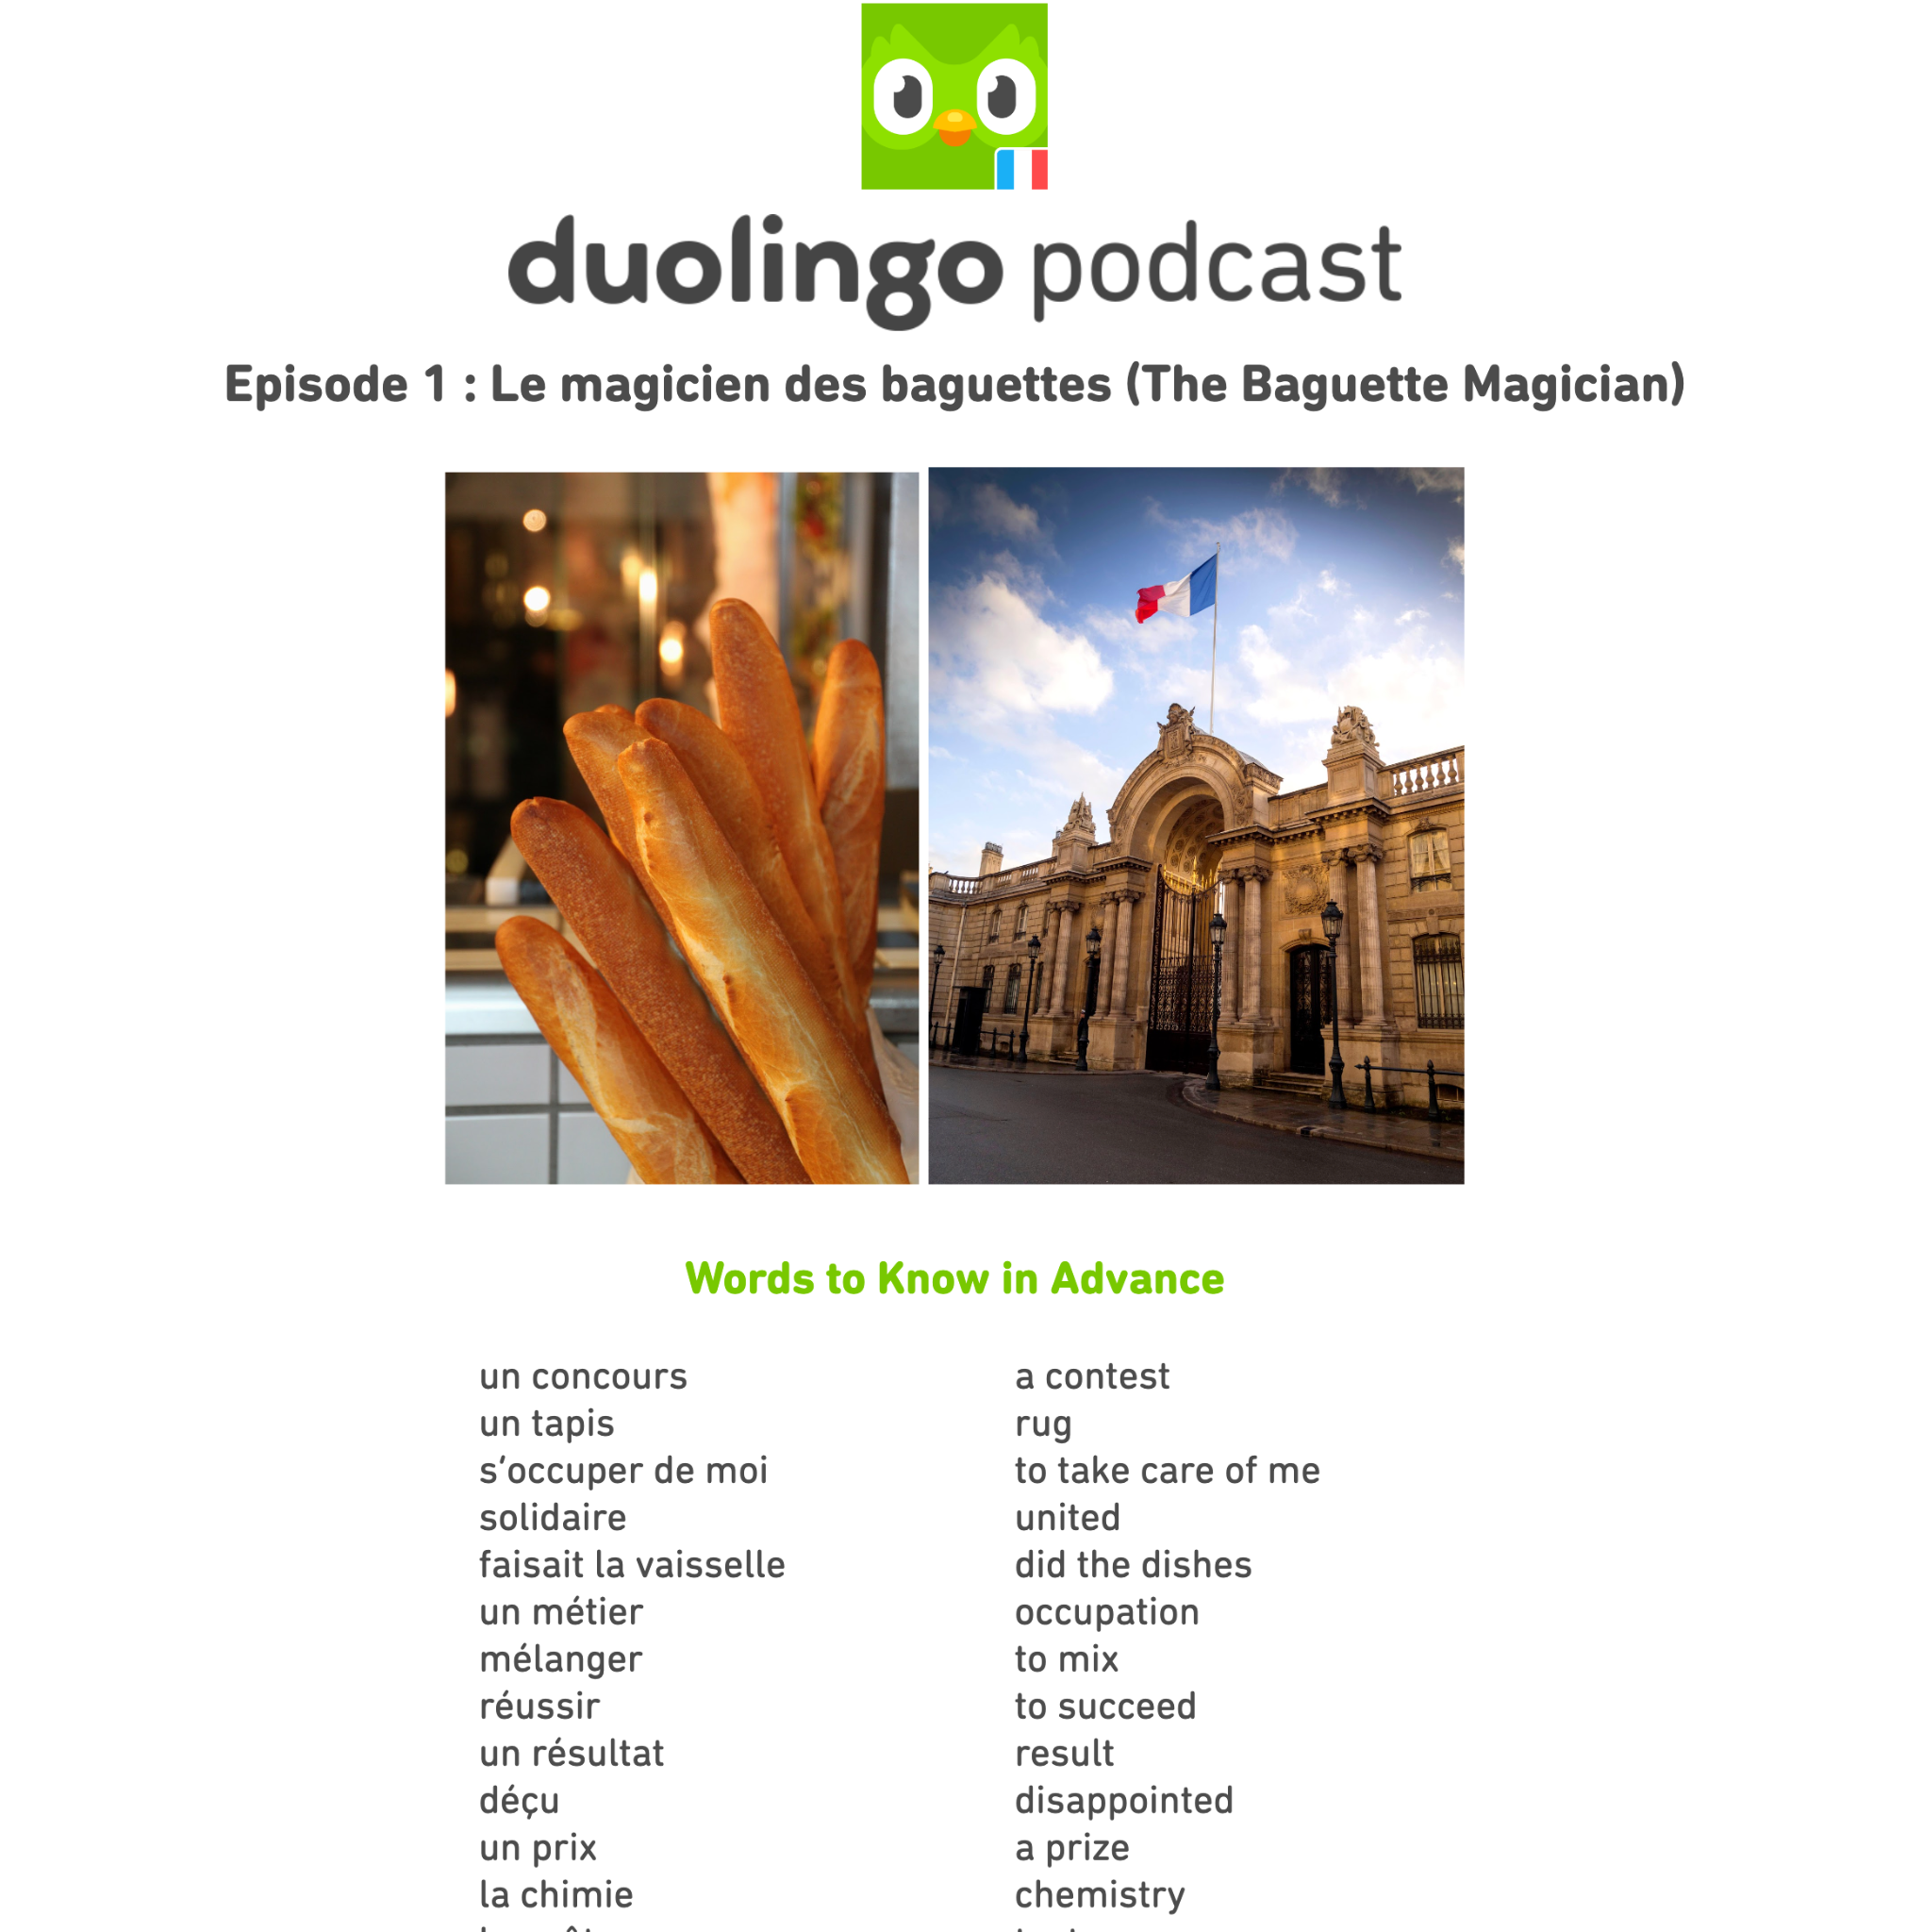
podcast guides
Notes:
Vocabulary list
Each worksheet begins with a list of useful vocabulary for understanding the episode. Want to get more creative?
Delete the English translations, and have students fill them in with a partner.
Put each word on an index card, and have students play vocabulary games like charades or taboo to learn them.
Have students make their own flashcards. They can write the new word on one side, and put on the other side either the English translation, an image of the word (that they create or print), or a sentence in the target language that will help them recall the word’s meaning.
Pre-listening questions
These are designed to prime students before a longer listening activity. When students can predict a little bit of what they’re about to hear, they understand better and enjoy it more!
Discuss the questions together as a class.
Do a Think-Pair-Share: let students stew on a question for a few moments, then tell a partner what they’re thinking, then finally share with the whole class.
Listening comprehension
You can stop the recording if you’re listening during class, or have students answer these for homework if they’re listening at home and encourage them to pause and rewind as necessary.. Some other ideas:
Consider whether to ask students to answer questions in English or in their learning language. Answering in English will ensure everyone in the class has understood, while answering in the learning language will give them practice speaking and summarizing in the target language.
If students listen at home, ask them to come up with their own comprehension questions to ask a partner in class the next day.
Have students make their own vocabulary lists as they listen, of words they’d like to learn.

Slide 6
podcast guides
Notes:
Post-listening comprehension
These ask students to put it all together and understand the story as a whole. Additional post-listening comprehension activities could include:
Have students draw the story in 4 frames: (1) who is the protagonist; (2) what is the obstacle encountered; (3) what does the protagonist do in response; (4) how is s/he changed at the end.
Ask students to write a summary of the episode. It must be 50 words or less. They can then compare their summaries with the actual summary on the website.
Show students the image associated with the episode on the website. Ask them if they think it’s a good selection, and why or why not. If they could choose a single image to describe the episode, what would it look like?
Discussion
These questions help students to move beyond just comprehending what happened, and to think critically about the protagonist, the story, and how it is told. More ideas:
Does this story relate to other things they’ve studied in your class? In another subject? Ask them to think about interdisciplinary connections across courses or units.
Make it personal! We’ve included at least one personal question in each worksheet, but you know your students best! What aspects of the episode might resonate with them? Have they, your school, or your town experienced something related to the theme of the episode?
Want to practice grammar? Ask students to write about what happened before we meet the protagonist using past tenses, or about what the protagonist will do next, using the future tense. Make them justify their ideas based on what they’ve gleaned from the story.
More fun stuff
These activities are meant to encourage students to use the target language outside of the classroom, in hands-on activities and everyday situations. Other possibilities:
Brainstorm other topics to research with your students, then assign those topics to groups for a research activity (remember: “research” is not just online searches and articles! Interview people in your town or school, visit monuments, and look at popular materials like magazines, blogs, and advertisements to glean more cultural information about a topic).
Have students plan a trip to the area focused on in the episode. What would they visit, when would they go, what would they need to pack or prepare?
If you use Integrated Performance Assessment, you could consider this an opportunity to do a more presentational activity, since the earlier activities are more interpretive and interpersonal:
Have students work in pairs to create their own podcast episode. One plays the host and the other the protagonist. They meet five years later and continue the discussion.
Students must give an oral pitch to the producers at Duolingo for a new podcast episode. You, another student, or the whole class could play the role of producer asking questions about their pitch.

Slide 7
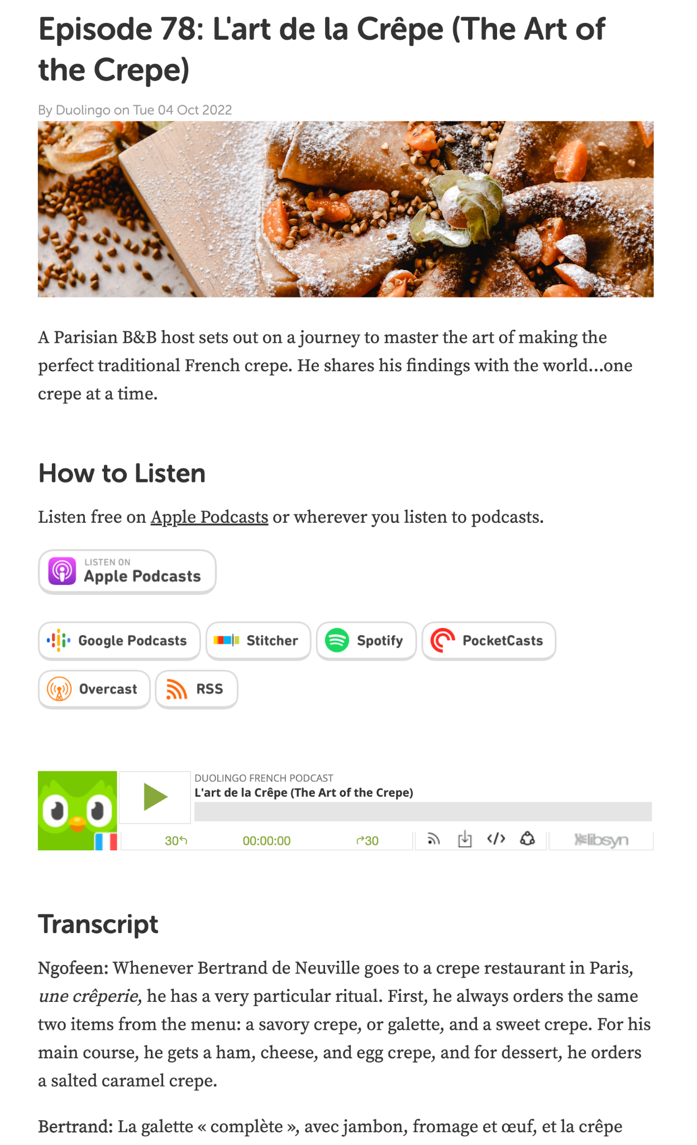
Helpful tips
transcripts of all the podcasts on desktop
podcasts are available on YouTube!
Notes:
Link to our podcast guides: in our shared google drive where we share resources, you’ll find both English and French or Spanish podcast guides! https://bit.ly/3fYZpPY
Link to the desktop podcasts: https://podcast.duolingo.com/ Pamela in the Educator’s Network pointed out that the Spanish and English podcasts were available on YouTube and that the visual aids were helpful for students

Slide 8
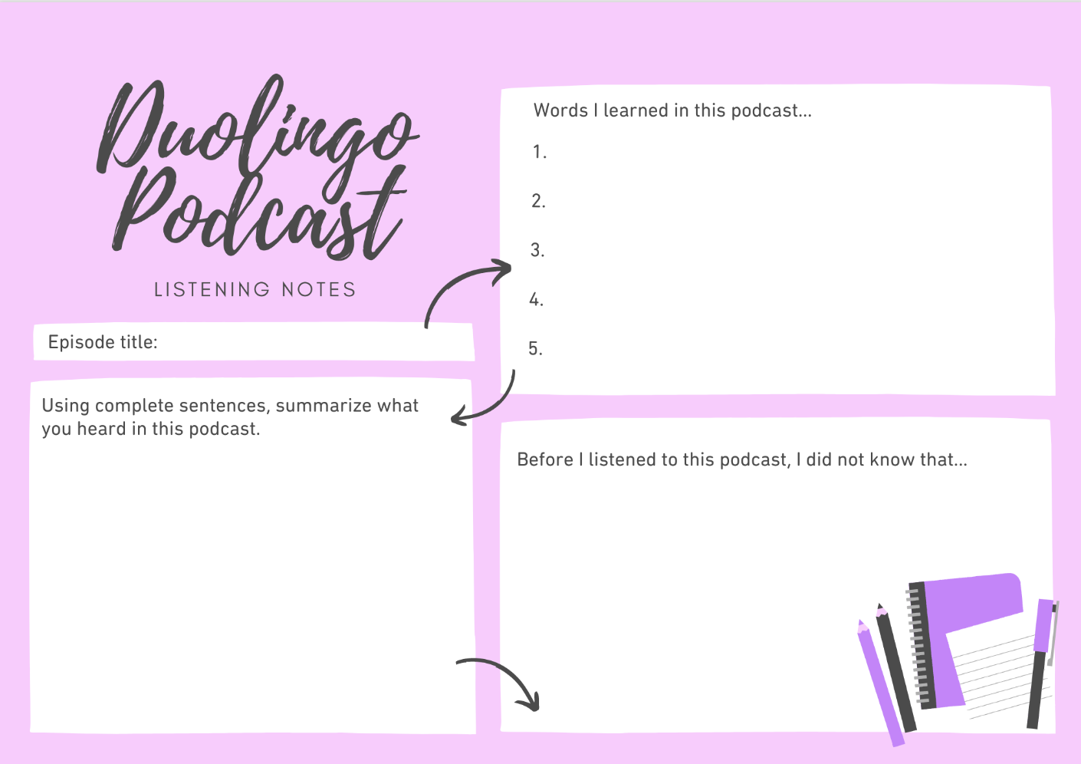
podcast notes
Notes:
You can use our handout “Duolingo podcast listening notes” to help you students take notes while listening either in their native language, or their learning language to make it even more challenging! Any new words that students learned during the podcasts could be used to make flashcards or shared and reviewed together as a class in the form of a vocabulary game for example.
Another great way to get those new vocabulary words really ingrained into their memory is to get them using them in their own sentences. I would even suggest flipping these listening notes over and asking students to start writing any sentences they’d like in the target language that include the new vocabulary. If the sentences are silly like some Duolingo sentences are, even better! Have students share them in class and see which sentences get the most laughs.

Slide 9
teacher examples

Slide 10
From our EdNet
“The last podcast that we listened to as a whole class, I printed the transcript, cut it up and distributed mini paragraphs to everyone in class. Then, after we would listen to a paragraph in Spanish, I would ask the person who had that section to translate/summarize what it meant for us. It helped to keep them following along and on task.”
Amy
“I create a word doc where I ask some "activate background knowledge" type Qs in English then make a 3 column table: 1 skinny column that's numbered, a main column where I paste each individual paragraph from the podcast, a third slightly narrower column where students define new words, summarize the Spanish paragraphs, or sometimes answer reflection Qs.”
Lake
“So the first thing I did was create a slideshow with the words printed. Then I pressed play on the sound file, and I recorded myself flipping through the slides and circling words with the mouse pointer and uncovering pictures at just the right time.”
Pamela
Notes:
Link to the EdNet: https://www.facebook.com/groups/duolingoeducators
Amy: The last podcast that we listened to as a whole class, I printed the transcript, cut it up and distributed mini paragraphs (what you see on the page) to everyone in class. Then, after we would listen to a paragraph in Spanish, I would ask the person who had that section to translate/summarize what it meant for us. It helped to keep them following along and on task. You could also have the students write a summary, or have them pick out X sentences and write them out and illustrate meaning or write the translation underneath.
Print out the transcript and cut up the target language chunks. Ask students to work in pairs or groups to put the script in the right order, based on what they remember of the story (this is also great reading practice, and will help those who had trouble understanding the story aurally to all be on the same “page” about what happened).
Lake: I create a word doc where I ask some "activate background knowledge" type Qs in English then make a 3 column table: 1 skinny column that's numbered, a main column where I paste each individual paragraph from the podcast, a third slightly narrower column where students define new words, summarize the Spanish paragraphs, or sometimes answer reflection Qs. Sometimes I have asked Ss to go back through and color-code the preterit and imperfect verbs (I use the Spanish podcasts) and we go over those as a class talking about why each is used.
Pamela: Pamela wanted to create visual aids for her French students - so here is what she did.

Slide 11
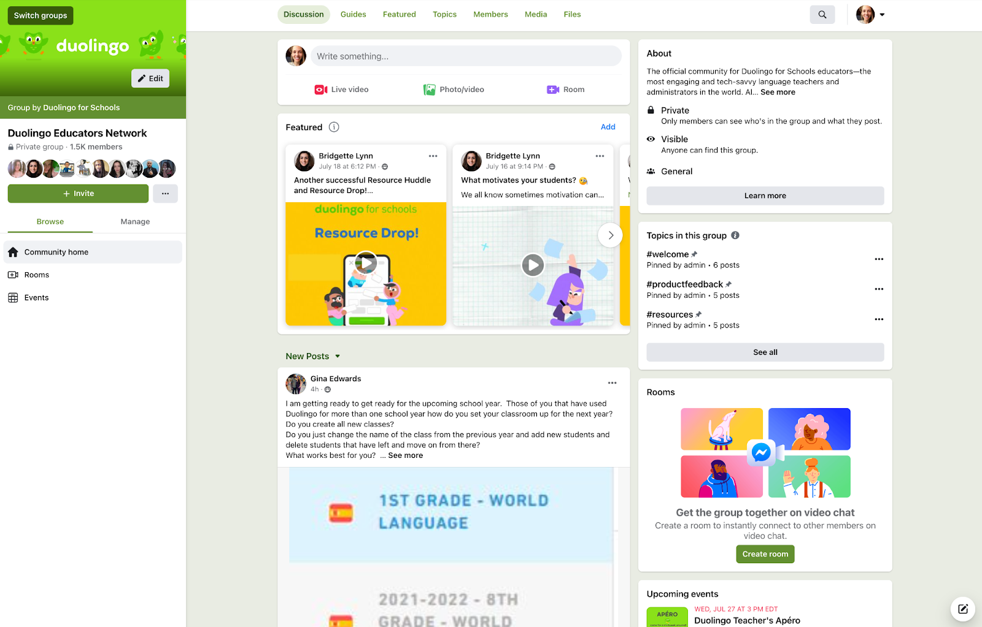
Join us on Facebook
Follow us on social
https://www.facebook.com/groups/duolingoeducators
Collaborate with other educators and with the Duolingo for Schools team
Twitter: @DuolingoSchools
TikTok: @Duolingoschools
Facebook: Duolingo for Schools
Instagram: @Duolingo4Schools
Notes:
And maybe one of the best things about Duolingo for Schools is our Educators Network. This Facebook group is full of educators from all over the world who are using Duolingo in new and exciting ways, and who are always up for answering questions, sharing ideas, or just hanging out. Jump into the group, and follow us on social media to get involved and stay connected.

Slide 12
interested in giving PD (+ want some swag)?
download this slide deck
schedule your pd session + invite attendees
fill out this form to share some info and pictures with us and get some swag
make sure to have your attendees fill out this feedback form, too!
Notes:
First 50 teachers to download and host any of our PD events (because there is more to come!) will be sent a swag box that includes stickers, an insulated tumbler, and a wool Duolingo beanie!

Slide 13
attendee recruiting ideas:
schedule a PD session with your department
post about it on Twitter and tag us
recruit teachers from the EdNet

Slide 14
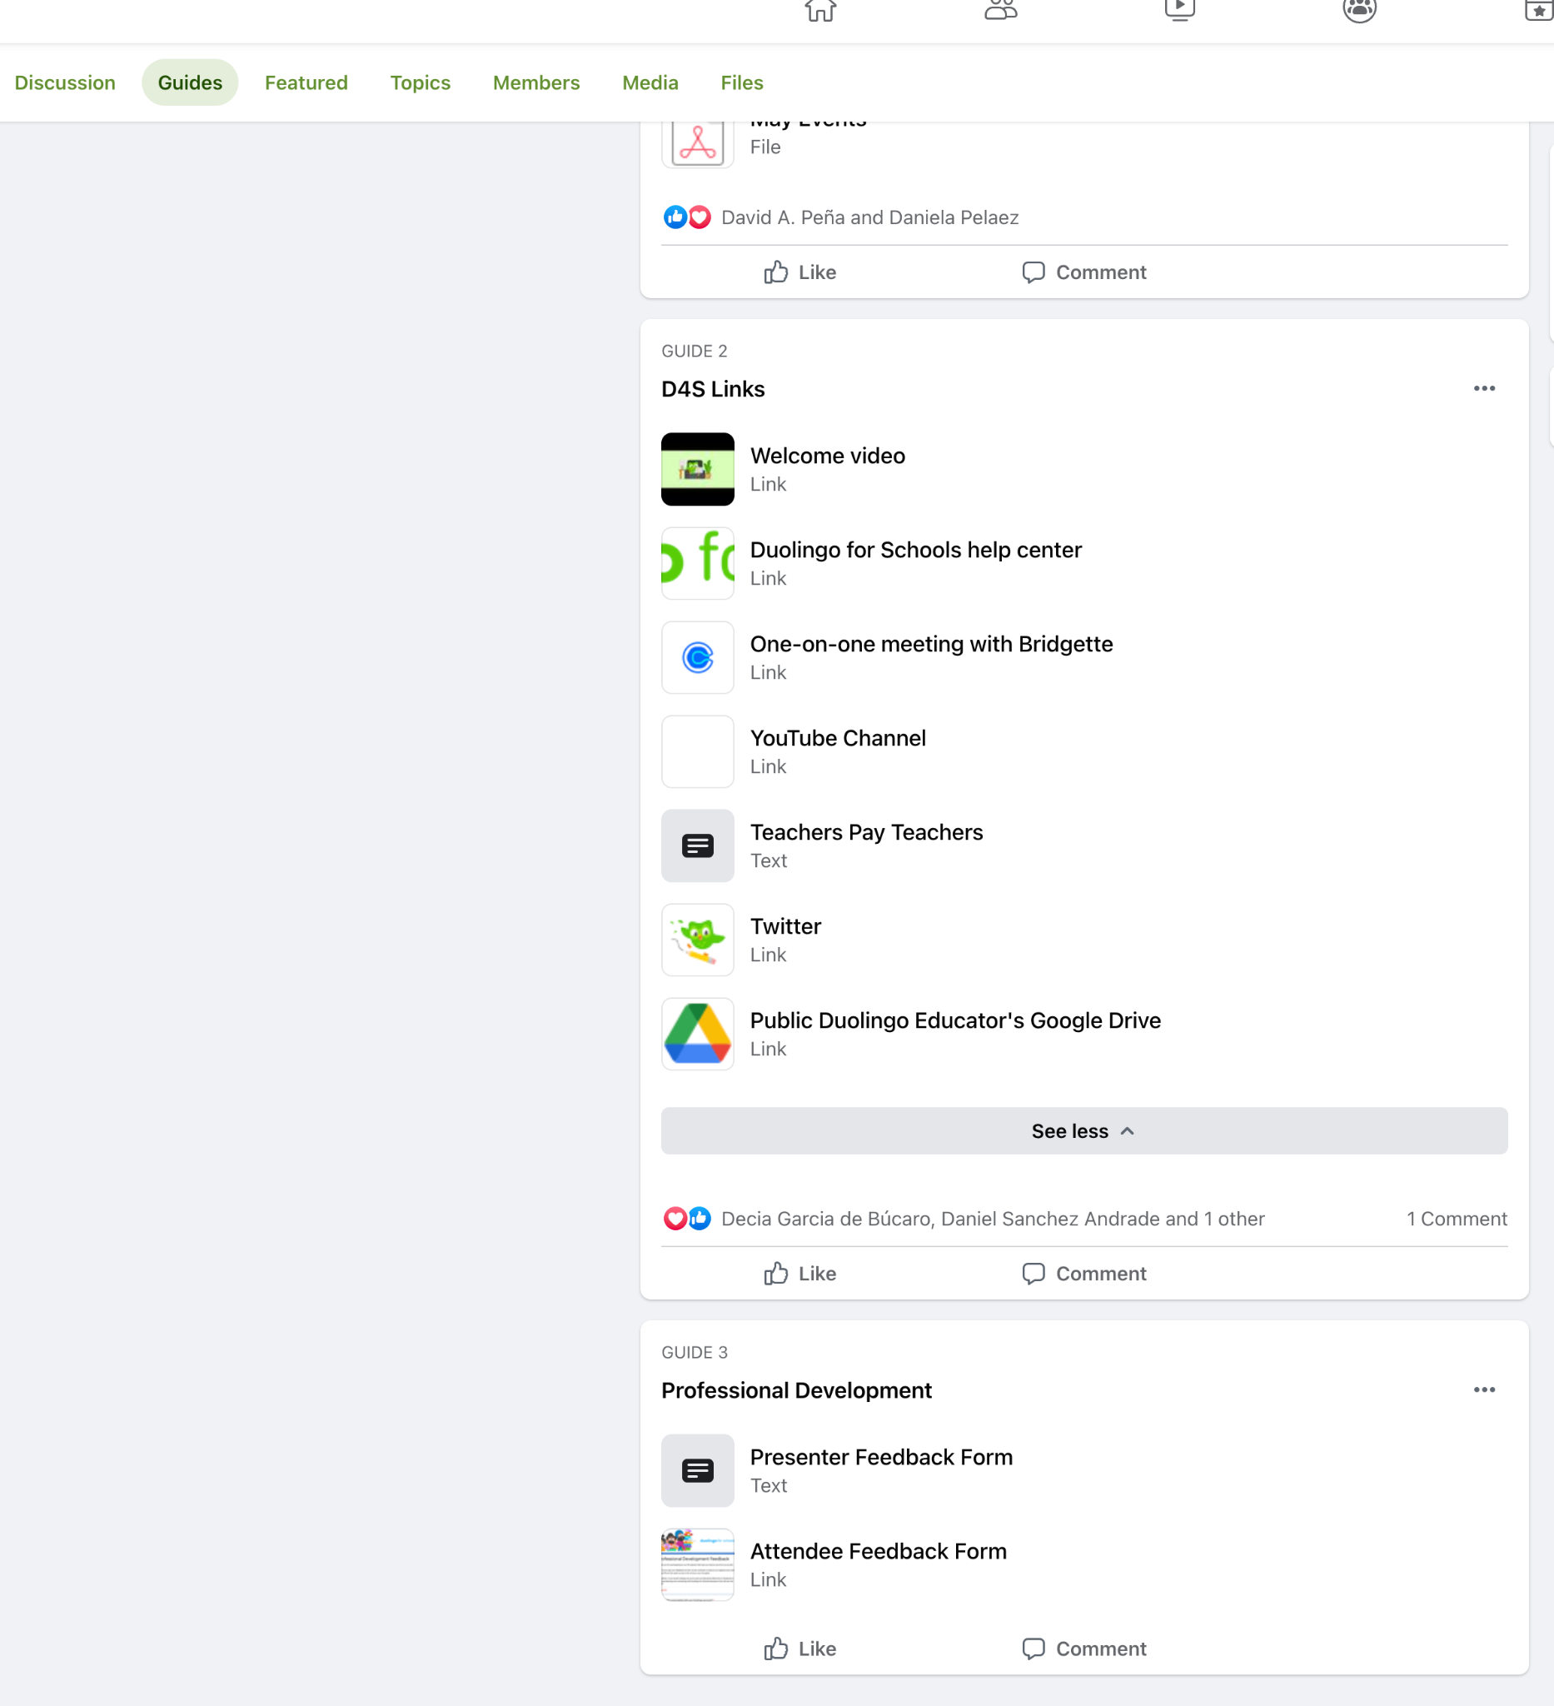
PD materials
Notes:
Presenter feedback form - after you have recruited some teachers and have done your PD session, you must fill this form out in order to get your swag! We will ask for some details such as who attended, a picture and an attendee list, as well as how it went!
Attendees feedback form - we ask that you provide this form to your attendees so that we can know a little on their end how the PD went and what kind of PD they’d like to see in the future.

Slide 15
PD work session ideas
Discuss techniques from the session and brainstorm new ideas
Break out into groups to brainstorm what these ideas might look like in the classroom
Create a new lesson plan around one of your (or our) ideas!

Slide 16
questions?
Check out our Help Center for more information or contact the team at educators@duolingo.com!
Notes:
If you have additional questions, you can find lots more information, or can reach out to our team, in our Help Center, which can be accessed from the left-hand side of your Duolingo for Schools dashboard.

Slide 17
thank you

